Slide 1
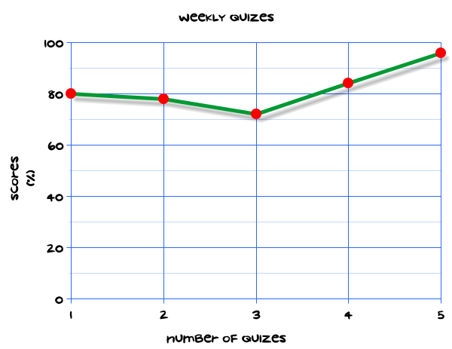
My Statistics Interactive Notebook
Name
Class
Teacher
Term 1 Semester 1
1

Slide 2
Create your own front page
It needs to contain the following –
My number interactive notebook
Name
Class
Teachers Name
Semester 1 Term 1
Page number 1

Slide 3
Contents
Glossary or Formula Page
Page
Date
Description
2
3

Slide 4
Tasks
24
7
30
Essential Question
Questions
Notes
Summary
4
5

Slide 5
24
7
30
Date
Title
EQ –
5

Slide 6
24
7
30
Date
Measures of Centre
EQ – Describe the differences between the different types of averages.
5

Slide 7
24
7
30
Date
Measures of Centre
EQ – Describe the differences between the different types of averages.
What is a measure of centre?
5

Slide 8
24
7
30
Date
Measures of Centre
EQ – Describe the differences between the different types of averages.
What is a measure of centre?
This finds the average value for a group of data
5

Slide 9
24
7
30
Date
Measures of Centre
EQ – Describe the differences between the different types of averages.
What is a measure of centre?
This finds the average value for a group of data
What are the averages?
5

Slide 10
24
7
30
Date
Measures of Centre
EQ – Describe the differences between the different types of averages.
What is a measure of centre?
This finds the average value for a group of data
What are the averages?
Mean , Median Mode
5

Slide 11
24
7
30
Date
Measures of Centre
EQ – Describe the differences between the different types of averages.
What is a measure of centre?
This finds the average value for a group of data
What are the averages?
Mean , Median Mode
How do I find the mean?
5

Slide 12
24
7
30
Date
Measures of Centre
EQ – Describe the differences between the different types of averages.
What is a measure of centre?
This finds the average value for a group of data
What are the averages?
Mean , Median Mode
How do I find the mean?
Add all the values together and divide by the number of values
5

Slide 13
24
7
30
Date
Measures of Centre
EQ – Describe the differences between the different types of averages.
What is a measure of centre?
This finds the average value for a group of data
What are the averages?
Mean , Median Mode
How do I find the mean?
Add all the values together and divide by the number of values
How do I find the median?
5

Slide 14
24
7
30
Date
Measures of Centre
EQ – Describe the differences between the different types of averages.
What is a measure of centre?
This finds the average value for a group of data
What are the averages?
Mean , Median Mode
How do I find the mean?
Add all the values together and divide by the number of values
How do I find the median?
Put the values I order. Find the middle value.
If there are two middle values add together and divide by two
5

Slide 15
24
7
30
Date
Measures of Centre
EQ – Describe the differences between the different types of averages.
What is a measure of centre?
This finds the average value for a group of data
What are the averages?
Mean , Median Mode
How do I find the mean?
Add all the values together and divide by the number of values
How do I find the median?
Put the values I order. Find the middle value.
If there are two middle values add together and divide by two
How do I find the mode?
5

Slide 16
24
7
30
Date
Measures of Centre
EQ – Describe the differences between the different types of averages.
What is a measure of centre?
This finds the average value for a group of data
What are the averages?
Mean , Median Mode
How do I find the mean?
Add all the values together and divide by the number of values
How do I find the median?
Put the values I order. Find the middle value.
If there are two middle values add together and divide by two
How do I find the mode?
The value that appears most often.
A data set could have 1 mode or 2 modes (bimodal) or no mode
5

Slide 17
24
7
30
Date
Measures of Centre
EQ – Describe the differences between the different types of averages.
How do I find the mean?
Add all the values together and divide by the number of values
How do I find the median?
Put the values I order. Find the middle value.
If there are two middle values add together and divide by two
How do I find the mode?
The value that appears most often.
A data set could have 1 mode or 2 modes (bimodal) or no mode
Example
Find the mean, median and mode for the following set of data
2 | 3 | 3 | 4 | 5 | 7
5

Slide 18

24
7
30
Date
Measures of Centre
EQ – Describe the differences between the different types of averages.
How do I find the mean?
Add all the values together and divide by the number of values
How do I find the median?
Put the values I order. Find the middle value.
If there are two middle values add together and divide by two
How do I find the mode?
The value that appears most often.
A data set could have 1 mode or 2 modes (bimodal) or no mode
Example
Find the mean, median and mode for the following set of data
2 | 3 | 3 | 4 | 5 | 7
Mean =$\frac{2+3+3+4+5+7}{6}=\frac{24}{6}=4$
5

Slide 19
24
7
30
Date
Measures of Centre
EQ – Describe the differences between the different types of averages.
How do I find the mean?
Add all the values together and divide by the number of values
How do I find the median?
Put the values I order. Find the middle value.
If there are two middle values add together and divide by two
How do I find the mode?
The value that appears most often.
A data set could have 1 mode or 2 modes (bimodal) or no mode
Example
Find the mean, median and mode for the following set of data
2 | 3 | 3 | 4 | 5 | 7
Mean =$\frac{2+3+3+4+5+7}{6}=\frac{24}{6}=4$
Median =
5

Slide 20
24
7
30
Date
Measures of Centre
EQ – Describe the differences between the different types of averages.
How do I find the mean?
Add all the values together and divide by the number of values
How do I find the median?
Put the values I order. Find the middle value.
If there are two middle values add together and divide by two
How do I find the mode?
The value that appears most often.
A data set could have 1 mode or 2 modes (bimodal) or no mode
Example
Find the mean, median and mode for the following set of data
2 | 3 | 3 | 4 | 5 | 7
Mean =$\frac{2+3+3+4+5+7}{6}=\frac{24}{6}=4$
Median =
5

Slide 21

24
7
30
Date
Measures of Centre
EQ – Describe the differences between the different types of averages.
How do I find the mean?
Add all the values together and divide by the number of values
How do I find the median?
Put the values I order. Find the middle value.
If there are two middle values add together and divide by two
How do I find the mode?
The value that appears most often.
A data set could have 1 mode or 2 modes (bimodal) or no mode
Example
Find the mean, median and mode for the following set of data
2 | 3 | 3 | 4 | 5 | 7
Mean =$\frac{2+3+3+4+5+7}{6}=\frac{24}{6}=4$
Median = $\frac{3+4}{2}=3.5$
5

Slide 22

24
7
30
Date
Measures of Centre
EQ – Describe the differences between the different types of averages.
How do I find the mean?
Add all the values together and divide by the number of values
How do I find the median?
Put the values I order. Find the middle value.
If there are two middle values add together and divide by two
How do I find the mode?
The value that appears most often.
A data set could have 1 mode or 2 modes (bimodal) or no mode
Example
Find the mean, median and mode for the following set of data
2 | 3 | 3 | 4 | 5 | 7
Mean =$\frac{2+3+3+4+5+7}{6}=\frac{24}{6}=4$
Median = $\frac{3+4}{2}=3.5$ (halfway between 3 and 4)
5

Slide 23
24
7
30
Date
Measures of Centre
EQ – Describe the differences between the different types of averages.
How do I find the mean?
Add all the values together and divide by the number of values
How do I find the median?
Put the values I order. Find the middle value.
If there are two middle values add together and divide by two
How do I find the mode?
The value that appears most often.
A data set could have 1 mode or 2 modes (bimodal) or no mode
Example
Find the mean, median and mode for the following set of data
2 | 3 | 3 | 4 | 5 | 7
Mean =$\frac{2+3+3+4+5+7}{6}=\frac{24}{6}=4$
Median = $\frac{3+4}{2}=3.5$ (halfway between 3 and 4)
Mode is 3
5

Slide 24
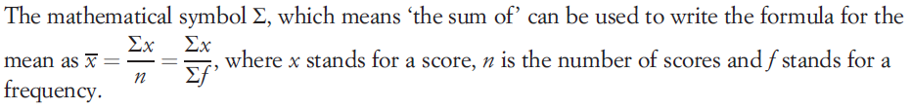
24
7
30
Date
Measures of Centre
EQ – Describe the differences between the different types of averages.
What symbols are used in
Statistics?
5

Slide 25

24
7
30
Date
Measures of Centre
EQ – Describe the differences between the different types of averages.
What symbols are used in
Statistics?
How do we find the mean of a frequency table?
5

Slide 26
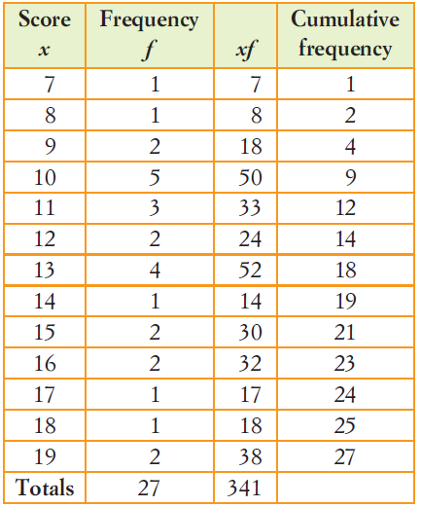
24
7
30
Date
Measures of Centre
EQ – Describe the differences between the different types of averages.
5

Slide 27
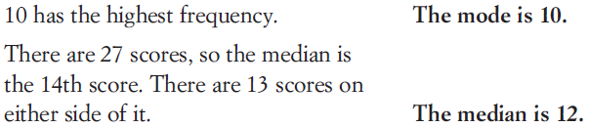
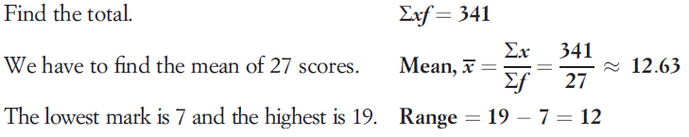
24
7
30
Date
Measures of Centre
EQ – Describe the differences between the different types of averages.
5

Slide 28
24
7
30
Date
Measures of Centre
EQ – Describe the differences between the different types of averages.
Outlier: is a data item (data value) that is much higher or lower than the other data values.
Outliers can affect the mean of a group of data.
Example: 2, 3.5, 1, 2.5, 5 billion.
Example: 35, 45, 40, 37, -6.
What is an outlier?
5

Slide 29
Task
Complete Numbers 1-3 on Page 40 of the text.

Slide 30
Questions

Slide 31
Notes Review
24, 7 ,30
Date
Title
Essential question
Notes complete
Notes complete with colour and diagrams
Questions completed
Contents page filed in
Formula page filled in

Slide 32
Homework
Review your notes and write a summary answering the essential question.

